Slide 1
Fuse in Action
2017

Slide 2
Agenda
Introduction
Installation and Quick start
Introduction to Fuse
Preview and export
Componentization
Responsive layout
Declarative animation
Structuring app resources
Realize your Idea ;)
Design the App
Create your UX Views.
Attack the JS.
Publish You app

Slide 3
Installation and Quick start

Slide 4
Installation and Quickstart
This is a step-by-step tutorial that takes you through setting up Fuse and creating your first project. Should you happen to run into problems during installation, please let us know!

Slide 5
Installation
The latest version of Fuse can always be downloaded from the downloads page. Download the installer for your operating system and open it to start the installation procedure.
Both the Windows and macOS installers require an internet connection in order to complete.
Windows: You may have to log out and in again (or simply reboot) to make sure the path for fuse is properly updated.
macOS: If for any reason you need to remove all of the Fuse components, you can use this uninstall script.

Slide 6
MacOS & Windows Requirements
MacOS Requirements
A modern Mac running macOS Yosemite or later
Windows Requirements
Window 7 or newer
OpenGL 2.1-capable GPU (Very basic on-board/shared resource GPUs such as the Intel GMA-series are not sufficient!!).

Slide 7
Finding a text editor
Fuse requires an external text editor in order to make changes to the UX markup in our app. To streamline your experience with Fuse, we provide plugins for some of the more popular text editors which provide code completion, error lists, output logs and the ability to launch Fuse apps from within the text editor.
We currently provide plugins for the following text editors:
Editor | Installation | Plugin homepage
Visual Studio Code | link | link
Atom | link | link
Sublime Text 3 | link | link

Slide 8
Starting a new project
To open Fuse, double click the the Fuse icon. On macOS it is located in the "Applications" folder.
If you are on Windows, it can be located in the start menu.
You can also start Fuse by running fuse from terminal on macOS or command prompt on Windows.
When opening Fuse, the first thing you'll see is the dashboard:

Slide 9
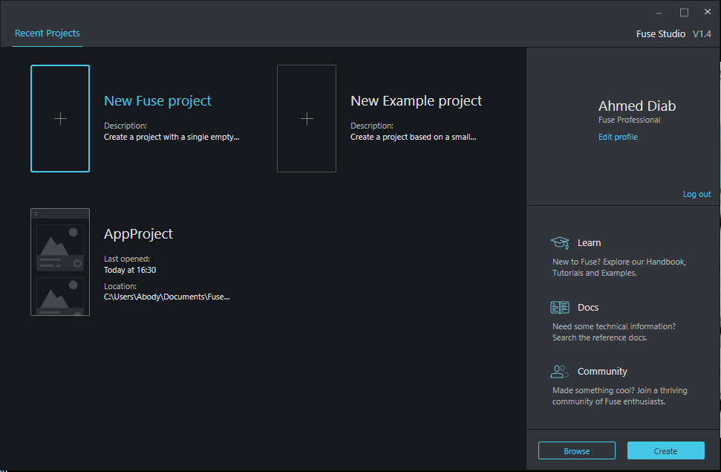
Starting a new project cont.

Slide 10
Starting a new project cont.
To start a new project, we first have to pick a template. Fuse comes with a few templates which provide a good starting point when starting from scratch. For the purpose of this guide, we want to choose the "New Fuse project" template. This template gives a project with one file in which we can easily start building our app. Choose this template by clicking the box with its name, and then click the "create" button. You will then have to pick a name and a directory for your project.

Slide 11
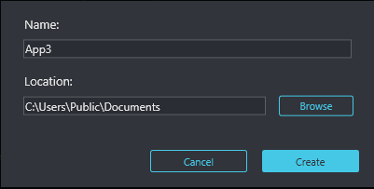
Starting a new project cont.

Slide 12
Starting a new project cont.
After clicking the "create" button, Fuse starts a local preview viewport. You'll notice that this process take some time, as Fuse has to download the packages containing the framework code used to create apps with Fuse. This only happens the first time Fuse is run after installation. You can see the download progress in the "Log" panel at the bottom of the window.

Slide 13
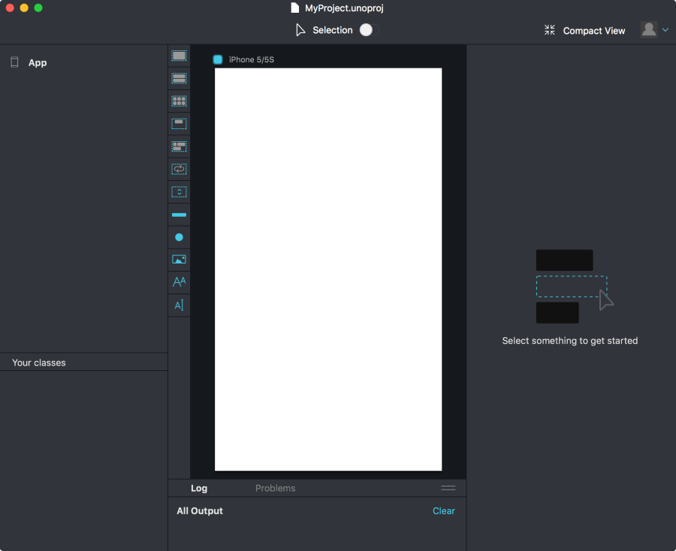
Starting a new project cont.
After Fuse is done downloading all the required packages, the preview viewport is started, and you'll notice that all we have to start with is a white background.

Slide 14
Logging in
You can log in to Fuse using your Fuse account. Click the log in button in the top right corner of Fuse to log in. If you have a Fuse professional license this is required in order to access the visual tooling that is a part of Fuse Studio.

Slide 15
Making some changes
To open the project in your text editor, either click the "Project" tab and select MainView.ux or open the project folder directly from your text editor.
To get started, paste the following code directly into MainView.ux , replacing the existing code:
<App Background="#2196F3">
<ClientPanel>
<StackPanel ItemSpacing="10">
<Text FontSize="30">Hello, world!</Text>
<Slider />
<Button Text="Button" />
<Switch Alignment="Left" />
</StackPanel>
</ClientPanel>
</App>

Slide 16
Making some changes
As soon as you save the document, you should notice the preview viewport update to display some Text, a Slider, a Button and a Switch control, stacked on top of each other vertically. Fuse picks up any change you make to your documents, and updates automatically and immediately to reflect those changes. This even works on your devices which you can read about in the next section.

Slide 17
Running Preview on device
Fuse' live preview can be run on both Android and iOS devices, even at the same time! To get your app running in preview mode on a device, there are a couple things we need to set up.
First of all, make sure both your phone and computer are hooked up to the same wireless network and is connected to your computer via USB. USB is used for the actual deployment (getting the app from your computer to your phone), while the live updates from Fuse is sent over Wifi.
Fuse offers two ways of running your app:
Preview - A fully working build of your app, which also updates in real-time as you make changes to your code.
Export - The final version of your app, which can be shipped to app stores or used for private testing.

Slide 18
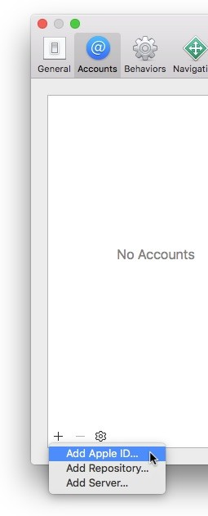
iOS (macOS only)
In order to deploy the Fuse preview app to your iOS device, you need Xcode installed. Xcode can be installed directly from the mac App Store. You need to register an apple developer account and log in with it in Xcode.
To build Fuse preview for iOS, select "Preview" -> "Preview on iOS" from the menu bar. Once Fuse is done building, it will open Xcode with the preview project. You then have to deploy this project to your iOS device from Xcode.

Slide 19
Android
You first need to install some dependencies which are required in order to build the APK which is deployed to your phone. This is done by running the following command in terminal on macOS or the command prompt on Windows
fuse install android
You also need to enable your device for development. This is done very easily by following these intructions. Note that step 1 is handled by Fuse, so this isn't something you need to worry about.
If you are running on Windows you might also need to install the right USB driver for your device. A list of drivers for common vendors, as well as instructions to install them, can be found here.

Slide 20
What next?
Now that you're all set up, it's time to get started learning the fundamentals of Fuse. A good next step is to take a look at the Introduction to Fuse module, which will take you through the fundamentals of Fuse. If you prefer learning by example, the hikr tutorial will lead you through the creation of a simple hiking app, while explaining each step along the way. If you simply want to start digging into example code and play around on your own, there is a ton of content to look at on our examples page as well as in the fuse-samples github repo

Slide 21
Introduction to Fuse

Slide 22
Introduction to Fuse
This module will provide you with an introduction to the fundamentals of Fuse and is a good place to be if you're just getting started. While we don't assume any prior experience with programming, some familiarity with markup languages can be helpful.
The goal of this module is to give you a good understanding of what makes up a Fuse app, and to gain some practical knowledge in the process.
We will also cover how JavaScript fits in with Fuse, so some experience with JavaScript will be helpful in that section.

Slide 23
New project
We start off by creating a new project. If you followed the quickstart guide, feel free to skip to the next section.
When you first open Fuse, you are presented with the Fuse dashboard. From here, you can start a new project using one of the provided templates, or open one of your previous ones. For this section, we want to create a new project using the "Fuse project" template. This gives us a good starting point for playing around with some of the core features of Fuse.

Slide 24

New project
After selecting the template, click "create". Pick a name and location and then click "create" again. When Fuse is done building your project you will be presented with a preview viewport with a white, blank screen.

Slide 25
Fuse projects
Every Fuse app consists of at least two files:
ProjectName.unoproj -- Contains information about the project, like which files to include, app icons, allowed screen orientations and much more.
MainView.ux -- The main UX file of our app. It is in UX files we do most of our work in Fuse. Anything from GUI layout to animations are put in these files.
New projects usually start off with a single UX file, but we can create as many as we want.

Slide 26
Fuse projects
When we start the Fuse preview, it looks for a .unoproj file in the folder we're in. As long as this file exists, and we have a .ux file with an App tag (we'll cover UX markup next), we have a valid Fuse project.
Why is it called .unoproj you might wonder? Fuse is built on top of a programming language called Uno. This means that when Fuse compiles your code, it is actually compiling an Uno project. Knowledge about Uno is not required in order to use Fuse, but for anyone who wants to dig deeper into the Fuse technology stack.

Slide 27
UX files
All UX file names end with the .ux file extension. UX is a markup language based on XML. It provides a powerful and expressive way of defining all visual aspects of our apps: GUI layout, animations, navigation structure, reusable components, input controls, and more.
Our chosen project template gives us only one UX file to start with, called MainView.ux . To start building your app, open this file in your text editor of choice. You'll notice the file only contains two lines of code; a pair of opening and closing App tags.
UX markup is explained in detail in the next section.
<App>
</App>

Slide 28
UX files cont’
Any Fuse project must, and can only, have one pair of App tags, and everything between these tags is a part of your app.
If you paste the following code into your MainView.ux file and save it, you'll notice the Fuse preview window updating with the text "Hello, world!" displayed in the top left corner. Don't worry too much about the code means, we will cover everything in the next section
<App>
<Text Value="Hello, world!" />
</App>

Slide 29
Introduction to UX
As mentioned in the previous section, UX is the way we do most of our work in Fuse. It is where we define everything visual, as well as animations and navigation. In this section we'll introduce the basics of UX markup.
If you're already familiar with XML, feel free to skip forward to the next sub chapter. The terminology is a bit different from regular XML though so it may be worth a look.

Slide 30
What is UX for?
UX is used for anything and everything visual. You define your app layout, all animations, navigation, and even gesture recognition in UX.
Layout is the act of arranging various shapes and controls on the screen. Fuse layout engine lets us easily define reactive layouts, that automatically adapt to different screen sizes and aspect ratios.
Animation is the act of making things change over time. Fuse comes with a state of the art declarative animation system, which lets you animate absolutely anything you can think of. Any object can be moved, and any property can be changed.
With navigation we define the structure of our app. Which pages exist, and how do we go from one page to the next. We can even define completely custom transitions in pure declarative UX.
UX is also used to define reusable components. Custom input controls can be created using the gesture and selection APIs, and can easily be turned into reusable packages that can easily be shared between several app projects.

Slide 31
What not to use UX for
UX is not used for fetching and transforming data. For that, we use JavaScript. While UX does have a powerful expression language built in, it is not a suitable scripting language. We also prefer to keep and mutate the app state in JavaScript.

Slide 32
Getting started writing UX
In spoken languages there are many ways to say the same thing. In UX we write what we want in a specific way so that Fuse can easily work out precisely what we are saying. When we talk about the 'way we write things' in languages we are talking about the Syntax of the language.

Slide 33
The syntax of UX (the way we write UX)
UX is made up of objects. What an object "does" or "what it's for" depends on it's name and where it is used. Objects can be written in two ways:
<Something />
<Something > </Something >
Right now, all we have to know is that the second version is used when we want to put other Objects inside our Something Object. Phew, it's all a bit abstract right now but once we plow through a few more details we can start seeing this stuff in context.
It is very common for people to talk about parts of the text in our UX so we need to know one extra thing: this is a tag <Name> More precisely the tag is what we call the thing that starts with < and ends with > . It will contain at least a name, but often more.
Up above we were showing two ways of writing an object:
<Something />

Slide 34
The syntax of UX (the way we write UX) cont’
This is an object that doesn't contain any other objects. When you see a tag ending in /> then it's called a 'self closing tag‘.
<Something > </Something >
Here we see that the <Something >tag doesn't end in /> so it needs to be closed. That's why the second tag starts with </ . It is saying that this is 'closing tag' for Something tag above.
Remember that even though example number two has 2 tags it is still one object. It's just one that can contain other objects as well.

Slide 35
Using this knowledge
If you are anything like me, then at this point your head is swimming with all these terms that we don't have a use for yet, so lets look at some real UX.
With our newly acquired prowess in UX we can read the UX above as:
We have a StackPanel Objects which contains 2 Text Objects
<StackPanel Orientation="Horizontal">
<Text Value="Hello Jim!" ></Text>
<Text Value="World" />
</StackPanel>

Slide 36
Using this knowledge cont’
We could also get super technical and point out some details:
But you may be looking at those opening and self closing tags above and wondering why they have extra stuff in them. If you are then well spotted! Those are called Properties
------------------------------------ Opening tag
/
V
<StackPanel Orientation="Horizontal">
<Text Value="Hello" /> <--------------- self closing tag
<Text Value="World" /> <--------------- self closing tag
</StackPanel>
^
------------------------------------ Closing tag

Slide 37
Using this knowledge cont’
If we have an apple in real life and you were asked about its properties, you might say "it's round" or "it's ripe" or something like that. Properties in this case gives us extra information about the nature of the apple. The exact same it true for Properties in UX.
Let's look back at the example above:
The Text object is what we use to show text in our App and the Value Property tells Fuse you want the text to be "Hello Jim".
Just like how an apple and a truck have different properties in real life, different objects in UX have different properties too. To find what properties you can put on each object type, we have lots of documentation to help.
<Text Value="Hello Jim!" />

Slide 38
Using this knowledge cont’
One last note on properties: when we have an object with opening & closing tags we only add the properties to the opening tag, so:
And given that we are talking about small details: objects that are inside other objects are called children. The objectthat contains them is called the parent object.
/ Only need properties on this one.
v <StackPanel Orientation="Horizontal">
</StackPanel>
^
We are not allowed to set properties here!

Slide 39
Using this knowledge cont’
Before we wrap up this part lets annotate our UX again with what we have learned
------------------------------------ Opening tag (named StackPanel). Parent to two objects.
/ ------------------------ Has an Orientation Property
/ /
V V
<StackPanel Orientation="Horizontal">
<Text Value="Hello Jim!" /> <----------- Child object / self closing tag / Has a Value Property <Text Value="World" /> <--------------- Another child / self closing tag / Has a Value Property </StackPanel>
^
------------------------------------ Closing tag

Slide 40
Classes
A class defines a recipe for an object. Fuse has lots of useful objects defined for you but very soon you will want to define your own.
Luckily all we have to do is make something we like and then tell Fuse that this is a recipe for making objects just like it.
For example, let's say we make a nice Rectangle with a Text object inside it:
<Rectangle Color="#f0a">
<Text Value="Button" Margin="10" />
</Rectangle>

Slide 41
Classes
Later on we decide we want to use this in lots of places in our app. All we have to do to turn this into a Class (a recipe for objects) is use ux:Class and give it a name.
And now we can use it just like any other object that came with Fuse!
<Rectangle ux:Class="TextRectangle" Color="#f0a"> <Text Value="Button" Margin="10" />
</Rectangle>
<TextRectangle />

Slide 42
Introduction to Layout
As we mentioned in the previous section; layout is the act of sizing and positioning elements on the screen. Since our apps are expected to run on a ton of different screen sizes, with different aspect ratios and pixel densities, creating app layouts is not as simple in the real world as it is in a prototyping tool. Now, that doesn't necessarily make it harder, you just have to be aware of how to properly structure things in order to get the expected layout on your various devices.
We do this in Fuse by grouping objects together using various different Panel types, each with their own layout behavior. Panels are in charge of positioning their children according to different predefined layout rules. In this section we'll cover the most important ones, and how they can be used together to easily create almost any app layout.
Before we get started looking at the various layout types, there are a couple concepts you should be aware of.

Slide 43
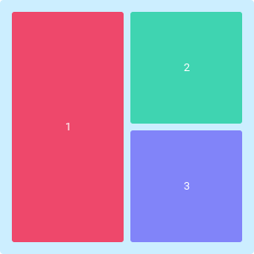
Available space
Each panel is in charge of assigning a size and position to all of its children. Each object (not just panels) has a certain available space in which it must place its children. How this size is determined can vary depending on the panel type, but most often it is assigned by the panels parent object, in just the same way as the panel assigns a size to its own children. It is a recursive process, where the available space is shrunk (or sometimes just kept the same) in each layer.

Slide 44
Alignment
All visual objects can also have an Alignment , which determines how an element should place itself in the case where it is smaller than its available space.
The Alignment property can be set to one of the following values:
Default - Stretches the object in all directions
Left - Aligns element to the left
HorizontalCenter - Centers element horizontally
Right - Aligns element to the right
Top - Aligns element to the top.
VerticalCenter - Centers element vertically.

Slide 45
Alignment cont’
Bottom - Aligns element to the bottom
TopLeft - Aligns element to the top left corner
TopCenter - Centers element horizontally and aligns it to the top
TopRight - Aligns element to the top right corner
CenterLeft - Centers element vertically and aligns it to the left,
Center - Centers element both horizontally and vertically
CenterRight - Centers element vertically and aligns it to the right
BottomLeft - Aligns element to the bottom left corner
BottomCenter - Centers element horizontally and aligns it to the bottom
BottomRight - Aligns element to the bottom right corner

Slide 46
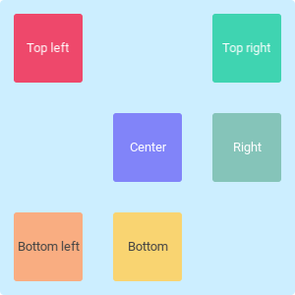
Alignment cont’
The following figure shows how objects respond to a handful of the alignment options listed above.

Slide 47
Layout types
Now it's time to learn about some layout types and how they can be combined to create almost any app layout you can think of. You'll be introduced to three layout types: StackPanel, DockPanel and Grid . Note however that these aren't the only layout types in Fuse. They are however by far the most commonly used ones, and cover most of the use-cases you'll run into. You'll see more of them listed in the outline at fusetools.com/docs.
The various panels we introduce here are actually just normal panels with an associated Layout type. What we mean by this is that a StackPanel is actually just a Panel with a StackLayout attached to it. Some of the available layout types do not have these Panel wrappers, and so you have to add them to a normal Panel yourself in order to use them.
Here is an example showing how you can use the ColumnLayout layout.
<Panel>
<ColumnLayout />
</Panel>

Slide 48
StackPanel
The StackPanel arranges its children in a line, either vertically or horizontally.
Notice that we've set the Height of each Rectangle to 50. This is necessary because rectangles don't have any implicit size. Otherwise, because of the way the StackPanel sizes its children, they wouldn't get any height at all. This is not necessary for Text objects since they have an implicit height based on their value and font size.
<StackPanel ItemSpacing="10">
<Rectangle Color="Red" Height="50"/>
<Text Value="Some text" />
<Rectangle Color="Blue" Height="50"/> </StackPanel>

Slide 49
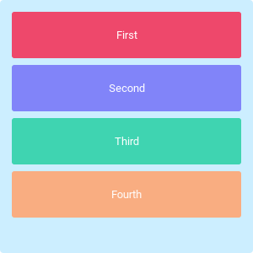
StackPanel cont’
You can read about the details of StackPanel in its reference docs.

Slide 50
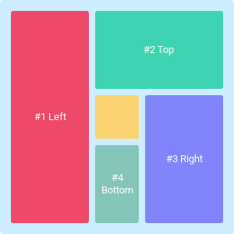
DockPanel
The DockPanel allows us to subdivide the available space by "docking" each child to one of its four sides, one after the other.
<DockPanel>
<Rectangle Dock="Left" Width="100" Color="Red"/>
<Rectangle Dock="Top" Height="100" Color="Green"/>
<Rectangle Dock="Right" Width="100" Color="Blue"/>
<Rectangle Dock="Bottom" Height="100" Color="Teal"/>
<Rectangle Color="Yellow"/>
</DockPanel>

Slide 51
DockPanel cont’
Just as with the StackPanel, we must set the height and width of some of the children. When docking to the left or right, we must ensure that the object being docked has some width, either by assigning a width explicitly like we've done here, or by making sure the object has its own implicit width. If we don't specify the Dock property for a child, it is stretched to fill the remaining space of the DockPanel.
Read all about the DockPanel here

Slide 52
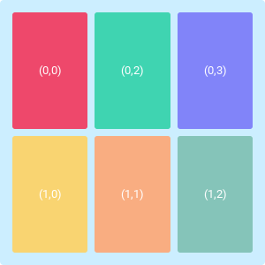
Grid
Grid lets us divide the available space into a set of rows and columns, and use those to place its children.
<Grid RowCount="2" ColumnCount="3">
<Rectangle Color="Red"/>
<Rectangle Color="Green"/>
<Rectangle Color="Blue"/>
<Rectangle Color="Yellow"/>
<Rectangle Color="Orange"/>
<Rectangle Color="Teal"/>
</Grid>

Slide 53
Grid cont’
In the example above, we've created a Grid with two rows and three columns, where each row has the same height, and each column has the same width. Unlike with the StackPanel and DockPanel, objects placed by the Grid don't need an explicit or implicit size, since they don't themselves affect the size of the cells (unless we use automatically sized rows/columns).
We have many options when defining the rows and columns of a Grid. The RowCount and ColumnCount properties provide us with a convenient way of defining a number of equally sized rows and columns, but there are other, more configurable, ways of defining them as well. You can read about it here.

Slide 54
Combining layout types to create something real
Lets combine what we've learned so far to create something a bit more complex than just a single layout panel.

Slide 55
Combining layout types to create something real cont’
<App Background="#ddd">
<DockPanel>
<Rectangle Dock="Top" Color="#63b8ff">
<Text Value="My first app" Alignment="Center" Margin="20"/>
</Rectangle>
<Rectangle Color="White" CornerRadius="5" Alignment="Center">
<StackPanel Alignment="Center" Margin="45">
<Text Alignment="HorizontalCenter" FontSize="35">This is</Text>
<Text Alignment="HorizontalCenter">our</Text>
<Text Alignment="HorizontalCenter" FontSize="25">first</Text>
<Image Url="https://www.fusetools.com/assets/dist/images/logo-white-header.png" Color="#333“
StretchMode="PixelPrecise"/>
<Text Alignment="HorizontalCenter" FontSize="30">App</Text>
</StackPanel>
</Rectangle>

Slide 56
Combining layout types to create something real cont’
<Grid ColumnCount="3" Dock="Bottom" Height="60" Color="White">
<Text Alignment="Center" Value="Left" />
<Text Alignment="Center" Value="Center" />
<Text Alignment="Center" Value="Right" />
</Grid>
</DockPanel>
</App>

Slide 57
Combining layout types to create something real cont’
The example above has three main parts. The outer most panel (right after the App object) is a DockPanel. Within this DockPanel we've placed three rectangles. Docked to the top, we've created an "app bar" with the title of our app and a blue/turquoise background. Docked to the bottom, we've made a dummy "navigation bar", which is quite common to see in most apps with more than a single page. This navigation bar consists of a Grid with three columns and just one (by default) row. It automatically places its three Text objects (its child objects) into these columns. Finally, we've added a stack of Text objects with an image in the middle, pointing to the Fuse logo using the Url property. Their parent StackPanel is inside a Rectangle which has a white background and some CornerRadius, to make its corners curved.
If you copy and paste this code into your MainView.ux and save the file, you'll notice how easy it is to get started creating realistic app layouts, with just a few lines of UX.

Slide 58
Adding some business logic with JavaScript
The easiest way to get started adding some JavaScript to our app is to add JavaScript object. We can then write JavaScript directly inside it, like so:
We can either write the code inline, like above, or keep it in its own file and reference it from UX:
<JavaScript> var some = "JavaScript code"; </JavaScript>
<JavaScript File="someJSFile.js" />

Slide 59
Adding some business logic with JavaScript cont’
In either case, the JavaScript object defines a CommonJS module. For our purposes, what this means is that there exists an object called module, through which we can export our variables to the outside world (our UX). By adding them to the exports member on the module object:
myVariable is now available from UX. In order to use it however, we need to create a binding to it. This is very easily done by enclosing the name in curly braces: {name}. In our case, we can bind to myVariable like so: {myVariable}. The following example shows how we would bind the Value property of a Text object to the myVariable variable:
<JavaScript>
var myVariable = 1234;
module.exports = { myVariable: myVariable }; </JavaScript>
<Text Value="{myVariable}" />

Slide 60
Adding some business logic with JavaScript cont’
Your can also bind events to functions:
<JavaScript>
function buttonClicked() {
console.log("A button was clicked");
}
module.exports = {
buttonClicked: buttonClicked
};
</JavaScript>
<Button Text="My button" Clicked="{buttonClicked}"/>

Slide 61
Displaying lists of data
Most apps need to display lists of content, and for a lot of apps this is how most of its content is displayed. You can export arrays of data from JavaScript just as you export any other variable. You might wonder how we build a list using UX? The answer is the Each Class
Each is a class that can be used to replicate an object once per item in an array. Each has a property called Items which we can bind to an array. It will then replicate whatever children it has once per item in that array. The following example creates a stack of colored rectangles, each with their own text item.

Slide 62
Displaying lists of data cont’
<JavaScript>
var ourList = [
{ text: "Welcome", color: "#7FDBFF" },
{ text: "to", color: "#01FF70" },
{ text: "Fuse", color: "#FF4136" },
{ text: "!", color: "#B10DC9" }, ];
module.exports = {
ourList: ourList };
</JavaScript>
<StackPanel>
<Each Items="{ourList}">
<Rectangle Color="{color}">
<Text Value="{text}" Margin="15,10" />
</Rectangle>
</Each>
</StackPanel>

Slide 63
Responding to changes in the data
In order to make our UI automatically update when we make changes to our data, we need a way to let it know that a something has happened. In Fuse, we do this through something called Observables. An Observable value is a value that can change over time. Other entities, like our UI, can subscribe to being notified of whenever one of these observable values have changed. To create an Observable value, we first have to get a hold of the FuseJS/Observable module:
With the observable module at hand, we can very easily create an observable value like so:
var Observable = require("FuseJS/Observable");
var observableValue = Observable(10);

Slide 64
Responding to changes in the data cont’
and make changes to it through its Value Prosperity:
if we data-bind to this variable, the UI will automatically update whenever we make changes to it.
We do not use the new keyword when creating Observable values.
observableValue.value = 40;

Slide 65
List observables
Observables can also act as lists of observable values. We create an observable list in the exact same way as we create observable values:
We can then display this list in the exact same way as we did with the array, except we can now also add and remove items and have the UI automatically update.
Check out the observable API reference for a full list of cool stuff you can do with observables.
var observableList = Observable(1,2,3,4,5) //observable list with 5 values
observableList.add(6);
observableList.remove(5);
observableList.removeAt(0);

Slide 66
When not to use JavaScript
While JavaScript is an extremely useful language, we want to make sure we use it for suitable tasks. In Fuse, we rely on JavaScript when we need to manipulate our app state or communicate with the outside world. That means such things as fetching data from a REST API, communicating with a chat server over web sockets, or saving user preferences to disk.
It is important to understand that all animations in Fuse are done purely in UX markup. Our animations can be parameterized by binding to JavaScript, but there is no event loop going on from the JavaScript side. All JavaScript happens on its own thread, asynchronously. Everything that is performance critical runs as close to the app UI as it can to keep animations fast and smooth.

Slide 67
Working with components
Componentization is a cornerstone of the Fuse workflow. Componentization is the act of splitting your UX into smaller reusable blocks, either as a means of styling, to reduce the need for repeating UX in several places, or just as a way of splitting our UX up into different files.
Since componentization is such an important part of Fuse, we've spent a lot of our time and effort in making it both simple and powerful. As mentioned earlier in this module; all that is needed in order to turn a piece of UX into a reusable component, is to add the ux:Class attribute to it, at which point we call that piece of UX a class definition. Lets see how we can use this to clean up the code we wrote in the layout chapter:

Slide 68
Working with components cont’
<App Background="#ddd">
<DockPanel>
<Rectangle Dock="Top" Color="#63b8ff">
<Text Value="My first app" Alignment="Center" Margin="20"/>
</Rectangle>
<Rectangle Color="White" CornerRadius="5" Alignment="Center">
<StackPanel Alignment="Center" Margin="45">
<Text Alignment="HorizontalCenter" FontSize="35">This is</Text>
<Text Alignment="HorizontalCenter">our</Text>
<Text Alignment="HorizontalCenter" FontSize="25">first</Text>
<Image Url="https://www.fusetools.com/assets/dist/images/logo-white-header.png" Color="#333" StretchMode="PixelPrecise"/>
<Text Alignment="HorizontalCenter" FontSize="30">App</Text>
</StackPanel>
</Rectangle>

Slide 69
Working with components cont’
<Grid ColumnCount="3" Dock="Bottom" Height="60" Color="White">
<Text Alignment="Center" Value="Left" />
<Text Alignment="Center" Value="Center" />
<Text Alignment="Center" Value="Right" />
</Grid>
</DockPanel>
</App>

Slide 70
Working with components cont’
This app screen has three logical components: the top bar, the bottom bar, and the card we've put in the center. Lets turn each into a component and put it in its own file:
AppBar.ux:
TabBar.ux:
<Rectangle ux:Class="TopBar" Color="#63b8ff">
<Text Value="My first app" Alignment="Center" Margin="20"/> </Rectangle>
<Grid ux:Class="TabBar" ColumnCount="3" Height="60" Color="White"> <Text Alignment="Center" Value="Left" />
<Text Alignment="Center" Value="Center" />
<Text Alignment="Center" Value="Right" />
</Grid>

Slide 71
Working with components cont’
Card.ux
<Rectangle ux:Class="Card" Color="White" CornerRadius="5" >
<StackPanel Alignment="Center" Margin="45">
<Text Alignment="HorizontalCenter" FontSize="35">This is</Text> <Text Alignment="HorizontalCenter">our</Text>
<Text Alignment="HorizontalCenter" FontSize="25">first</Text>
<Image Url="https://www.fusetools.com/assets/dist/images/logo-white-header.png" Color="#333" StretchMode="PixelPrecise"/>
<Text Alignment="HorizontalCenter" FontSize="30">App</Text> </StackPanel>
</Rectangle>

Slide 72
Working with components cont’
and with these three components in place, we can simplify our MainView.ux into the following:
Doesn't that look a lot cleaner? Note that we didn't make the Dock and Alignment properties a part of the class definitions. That is because the decision of how to align or dock an object belongs at the place the object is create, not where its class is defined. This is however just a convention - the app would work just as well with these properties set on the class definition, it would just have been the wrong place to make the decision about docking.
<App Background="#ddd">
<DockPanel>
<TopBar Dock="Top"/>
<Card Alignment="Center" />
<TabBr Dock="Bottom"/>
</DockPanel>
</App>

Slide 73
App structure and testing
In this section we want to give you a general idea of how we structure apps in Fuse. We will also cover how to get started writing unit tests.

Slide 74
Structuring an app for scale
When just getting started with Fuse, it's ok to just put everything in one file. While we're just prototyping a single screen, this can even make it easier and faster to iterate. As our app grows however, we need to start thinking more about how to properly structure our app so that it doesn't become difficult to manage.
We usually separate between three component types in Fuse apps. We therefore like to separate our UX files based on what type of component it contains, and group them in different folders:
Components
Pages
Styles

Slide 75
Structuring an app for scale cont’
In your Components folder, you'll add your custom components, which are created specifically for this app, but which are not in themselves entire pages. Here might be a "tab bar control", a custom "switch" or various list view items which should appear in more than just one list.
The Pages folder contains all the pages of our app. Most, if not all, components in this folder will derive from the Page class. Although deriving from Page is usually not strictly necessary to be used in navigation, we consider it good practice, since it conveys both meaning and adds some additional properties which can be useful in the context of navigation.
Styles contain styled components, which are defined to give your app a consistent look. Text classes with specific font and font sizes as well as styled with the correct colors. You will also want to define sizes and margins which should be the same across your entire app.

Slide 76
Testing
You can easily add unit tests for your Fuse projects using the ux:Test attribute:
We can then run our tests using the following command from the terminal (on macOS) or command prompt (on Windows) while in your project directory:
<Panel ux:Test="AUnitTest">
<JavaScript>
throw new Error("This test fails")
</JavaScript>
</Panel>
<Panel ux:Test="AnotherUnitTest">
<JavaScript>
console.log("This test will pass");
</JavaScript>
</Panel>
uno test ProjectName.unoproj

Slide 77
Testing cont’
If a test throws an error, it will be regarded as failing. If nothing is thrown, the test passes. Pretty simple! Check out the ux:Test documentation for more details.
The current implementation of unit tests in Fuse is quite rudimentary. You can expect the testing API to be expanded upon in the future.

Slide 78
Animation basics
Fuse comes with a declarative and extremely expressive animation system, which is both easy to learn and very fun to play with.
There are two core concepts you need to grasp in order to create animations in Fuse: triggers and animators. In short, triggers are objects that respond to events or user input and which activate animators, while animators are in charge of transforming objects or changing their properties over time in response to being activated by triggers. A very nice thing about animators in Fuse, is that they always know how to undo themselves. This means that you never have to make sure you animate your objects back into place whenever a trigger is deactivated; this is taken care of by Fuse.
An important thing to understand about animations in Fuse, is that they describe a "deviation from a rest state". The rest state is the app as you describe it in UX, before any animation. If we for example are creating a button, we usually define the rest state of the button to be the "unpressed" state. We can then easily describe how the button should look when we press it using a WhilePressed trigger. The following example creates a custom button which is scaled down while it is pressed:

Slide 79
Animation basics cont’
Any visual object in Fuse is clickable, so animating in response to the user pressing is as simple as adding a WhilePressed trigger as a child. Following is a quick introduction to some of the most useful triggers and animators. For the complete list, checkout the triggers and animators ux references.
<Rectangle ux:Class="AnimatedButton">
<Text Value="Press me" />
<WhilePressed>
<Scale Factor="0.8" Duration="0.2" />
</WhilePressed>
</Rectangle>

Slide 80
Triggers
WhilePressed - active as long as your finger is on the object
Clicked - activates when you press and release the finger on the same object. Deactivates as soon as it is done activating.
WhileTrue - Can be toggled from UX, or data-bound to a boolean value in JavaScript.
Adding-/RemovingAnimation - Used to animate objects that are added or removed from the visual tree.
LayoutAnimation - Used to animate objects when they are assigned a new position or size by the layout engine.
WhileActive - Is active as long as it is in the currently active page (we briefly discuss navigation in the next section).

Slide 81
Animators
Move - Moves the object around
Scale - Scales objects. This scaling does not affect layout.
Rotate - Rotates an object. This is by default a 2D rotation, but Fuse can also do rotations in 3D.
Change - Change allows you to animate any property.
In the following example, we've extended our button to have a more complete animation. We now change its color, scale, and shadow distance, to make it look more natural. We've also added some nice Easing curves to it.

Slide 82
Animators cont’
<Rectangle ux:Class="AnimatedButton">
<Shadow ux:Name="shadow" Distance="7" Angle="45"/>
<Text Value="Press me" Color="White" Margin="18,14"/>
<LinearGradient StartPoint="0,0" EndPoint="1,0">
<GradientStop ux:Name="stop1" Color="#23A1AD" Offset="0" />
<GradientStop ux:Name="stop2" Color="#28B892" Offset="1" />
</LinearGradient>
<WhilePressed>
<Change stop1.Color="#4EC4A7" Duration="0.15" />
<Change stop2.Color="#43B4BD" Duration="0.15" />
<Change shadow.Distance="4" Duration="0.15" Easing="CubicOut" EasingBack="CubicIn"/>
<Move Vector="-2,2,0" Duration="0.15" Easing="CubicOut" EasingBack="CubicIn"/>
<Scale Factor="0.95" Duration="0.15" Easing="CubicOut" EasingBack="CubicIn"/>
</WhilePressed>
</Rectangle>

Slide 83
Navigation basics
Most non-trivial apps consists of more than just one screen. When making multi-page apps, it is important to have a clear way of defining how one can move between pages. Fuse has its own hierarchical navigation system, based on the Router and Navigator classes. By using this system we automatically get the ability to keep track of navigation history, and make use of the hardware back button in the case of Android. Learning to use this system is however beyond the scope of this module, so if you're interested, take a look here.
For the purpose of just getting started, lets take a look at a different navigation primitive in Fuse, called the PageControl. The PageControl, although more limited in its usage, is an extremely useful control. It allows us to swipe with our finger to navigate horizontally (by default) between as many pages as we want. Lets create an app with three pages, each with its own full screen color:

Slide 84
Navigation basics cont’
<App>
<PageControl>
<Page Color="Red" />
<Page Color="Green"/>
<Page Color="Blue"/>
</PageControl>
</App>

Slide 85
Navigation basics cont’
It's that simple! Feel free to open up one of the pages and start adding some content to the pages. Just open the Page object and put whatever you want in between. You can also try moving the pages to their own files using the ux:Class attribute discussed earlier.
<App>
<PageControl>
<Page Color="Red">
<Text Value="This is some content" Alignment="Center" FontSize="35"/>
</Page>
<Page Color="Green">
<AnimatedButton Alignment="Center" />
</Page>
<Page Color="Blue">
<Rectangle CornerRadius="10" Color="#f0f" Width="100" Height="100"/>
</Page>
</PageControl>
</App>

Slide 86
What is Uno?
We've mentioned the Uno programming language a couple times in this module, so we'll spend this last chapter setting the record straight about what Uno is, and how it might affect you.
Uno is a programming language, quite similar to C#, which is the basis on which Fuse is built. Does this mean you need to learn Uno to create apps in Fuse? Absolutely not. The only case where you might need to use Uno, is if you're implementing a wrapper for some native library which has still not been covered by us or the community. While the Fuse components you use in UX markup are mostly implemented in Uno code, we have strived to make these APIs as expressive as possible, so that you can make whatever you can imagine in pure UX markup, and then rely on simple JavaScript for the business logic.
That being said, Uno does have some very neat features, which, if you envision yourself as someone who might be interested in poking a bit deeper into the inner workings of Fuse, might be interested in. One of these features, and perhaps the most important one, is the ability to write Java and Objective-C directly in the language as foreign code blocks. This makes interop with native libraries extremely convenient and easy to get started with. That's not to say you'll never run into any challenges when interacting with third party native libraries, but we are constantly working on imporoving language level interoperability provided by Uno.

Slide 87
Preview and Export

Slide 88
Preview and Export
Fuse offers two ways of running your app:
Preview - A fully working build of your app, which also updates in real-time as you make changes to your UX markup or JavaScript.
Export - The final version of your app, which can be shipped to app stores or used for private testing.
When developing your app, you typically work in preview all the time, to be able to iterate quickly. Then you export when you want to deploy it. Note that in some scenarios, preview performance can be a bit slower than in export.

Slide 89
Setup
Android setup
To be able to preview or export to Android, you need to install the required SDK components. Pull up your terminal and run the following:
fuse install android
(You do not need sudo on macOS)
This will attempt to locate existing Android SDK components, and install them if necessary.
If you are running Windows you also need to install the right USB driver for your device. A list of drivers for common vendors, as well as instructions to install them can be found here.
Also on your android device itself you will need to enable 'developer options' & 'USB debugging'. For info on how to do this please see the official docs here.

Slide 90
Setup cont’
iOS setup
You will need Mac OS X and Xcode to preview and export your app to iOS.
You also need to create a free Apple Developer account and register it under Xcode's settings as shown below.

Slide 91
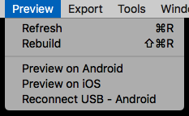
Preview
We can easily preview apps both locally and on Android/iOS devices while getting immediate feedback on changes to the UX markup and JavaScript.
Note: When running preview for iOS, Fuse doesn't run your app directly, but will open the project in Xcode. From there, press the "play" button to run the preview session.
When we open a project in Fuse, it starts in preview mode inside the tool. Users with a Fuse Pro license will also see visual tools to inspect and modify the app. To start preview on a device, use the "Preview" menu.
You can start preview on as many devices as you like. A USB connection is only required when starting preview, after that all changes are streamed over wifi.

Slide 92
Preview from editor plugins
Preview can also be launched from one of our editor plugins. Select preview target Android / iOS to launch on a device, or local to open it in Fuse.

Slide 93
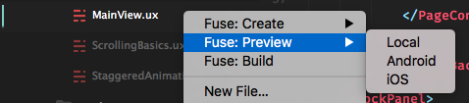
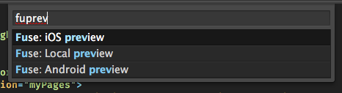
Preview from Sublime Text
To preview from sublime text, right-click any ux or unoproj file in the sidebar and select your target platform under the Fuse: Preview menu.
We can also start preview from the command palette. Press Cmd+Shift+P (OS X) or Ctrl+Shift+P (Windows) to bring up the palette, and type Fuse Preview to see a list of preview targets.

Slide 94
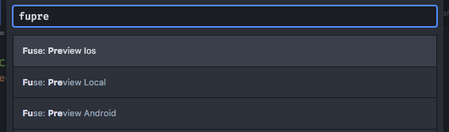
Preview from Atom
Press Cmd+Shift+P (OS X) or Ctrl+Shift+P (Windows) to bring up the command palette, and type Fuse Preview to see a list of preview targets.

Slide 95
Preview from command line
In your terminal, cd to the your project's directory, and run the command that corresponds to your build target.
fuse preview -t=Android
fuse preview -t=iOS
fuse preview -t=Local # The -t=Local flag is optional in this case
We can get further documentation on fuse preview by running fuse help preview.

Slide 96
Export
When exporting your app, your UX markup is compiled to native C++ code, meaning that you lose the ability to preview your app in real time. However your app will function on its own, without a network connection back to your computer. Performance is also better in many cases. This is what you want when distributing your app.
The simplest way to export is to use the "Export" menu in Fuse. However, the command line provides more options.

Slide 97
Android
In the project root, run the following command in your shell:
fuse build --target=Android –run
This will deploy and start the project on your connected Android device.
To make a release build, run:
fuse build --target=Android --configuration=Release
Note: to export your app to the Google Play Store, you need to sign it first.

Slide 98
iOS
In the project root, run the following command in your shell:
fuse build --target=iOS –run
If you instead want to open the generated project in Xcode, run fuse build --target=iOS –adebug
To make a release build, run:
fuse build --target=iOS --configuration=Release
Note: to export your app to the App Store, you need to sign it first.

Slide 99
Componentization

Slide 100
Components and reusability
UX Markup is a composable declarative language where existing components can easily be combined into new, more complex components. Componentization is an important part of Fuse, and central to achieving good code structure.

Slide 101
How to create components
A component is defined using the ux:Class attribute. This turns the object it is on into a class definition, meaning we can reuse that piece of UX in as many places as we want. A class definition also inherits all the properties of the class it is created from (sometimes called its parent class or super class). When we create an object from a class definition, we say that we are creating an instance of that class. The following example defines a class called MyButton which inherits from Panel and contains a Text object.
------------------- parent class
/ ----- class name
v v
<Panel ux:Class="MyButton" Color="#09d" Margin="4">
<Text Value="Button text" Alignment="Center“
Margin="20,10" Color="#fff"/>
</Panel>

Slide 102
How to create components cont’
It can then be used anywhere, like so:
Take a look at the ux:Class documentation for more details about ux:Class.
<StackPanel>
<MyButton />
<MyButton />
<MyButton />
</StackPanel>

Slide 103
What do we mean by inheritance
When we say that MyButton inherits from Panel, what we really mean is that MyButton will get all the same properties as Panel, as well as any new properties we define ourselves. That means that a class without any extra children or properties (custom properties are covered in the next section) added acts as exactly the same as its parent class:
In this case, Panel and NotSoSpecialPanel behave exactly the same.
<Panel ux:Class="NotSoSpecialPanel"/>
<Panel />
<NotSoSpecialPanel />

Slide 104
Defining properties
In many cases, like with our custom button, we want to create an interface to our component that allows us to specify various properties on a per instance basis. For our custom button for example, we want to be able to specify a different text for each instance:
The ux:Property attribute allows us to send data to our component, give default values and even animate it:
<MyButton Text="Custom button text"/>
<Panel ux:Class="MyButton" Color="#09d" ButtonText="Default text" Margin="4">
<string ux:Property="ButtonText" />
<Text Value="{ReadProperty ButtonText}" Alignment="Center" Margin="20,10" Color="#fff"/> </Panel>

Slide 105
Defining properties cont’
Take a look at the ux:Property documentation for more details about creating properties.
<StackPanel>
<MyButton ButtonText="First" />
<MyButton ButtonText="Second" />
<MyButton ButtonText="Last" />
</StackPanel>

Slide 106
Specifying dependencies
In some cases, our components cannot work alone and need a way to express that they depend on some other part of our UX defined outside of our component. This could be to animate it or trigger an event. A very common use case is needing to share a common Router instance among several pages. The way this use case is different from our use of ux:Property is that we require our component to get a Router when it is instantiated. This way, from our components perspective, it always has a Router available. For this we use the ux:Dependency attribute:
If we try to instantiate our component without specifying the router dependency we will get a UX compilation error, since this component cannot function without a Router. Unlike properties, dependencies cannot have default values.
<Router ux:Dependency="router" />

Slide 107
Specifying dependencies cont’
From within the class definition, dependencies can be used exactly in the same way as if they were defined with the ux:Name attribute:
Both the WhileTrue declared as a dependency and the one declared with ux:Name can be referenced directly using the name myTrigger. Therefore, we cannot use the same identifier for a ux:Dependency and a ux:Name.
The following example shows how we can use ux:Dependency to toggle the state of a WhileTrue defined outside the class definition.
<WhileTrue ux:Dependency="myTrigger" />
<WhileTrue ux:Name="myTrigger" />

Slide 108
Specifying dependencies cont’
Take a look at the ux:Dependency documentation for more details.
<Panel ux:Class="DependentPanel" Color="Blue">
<WhileTrue ux:Dependency="aTrigger" />
<Clicked>
<Toggle Target="aTrigger" />
</Clicked>
</Panel>
<WhileTrue ux:Name="showSomething">
<Text Value="The panel was clicked" Color="White" Alignment="Center" />
</WhileTrue>
<DependentPanel aTrigger="showSomething" />

Slide 109
Inheriting dependencies
Dependencies are not forwarded when you subclass. Therefore, you have to manually forward them to the baseclass you are sublcassing:
You can find more details about the ux:Binding attribute here.
<Page ux:Class="A">
<Router ux:Dependency="router" />
</Page>
<A ux:Class="B">
<Router ux:Dependency="router" ux:Binding="router" /> </A>

Slide 110
Inner logic using JavaScript
Components can contain custom business logic using the JavaScript tag. Here we can define local state as well as functions that act upon dependencies or other components. The following component takes a Router as a dependency, and uses it through JavaScript.
<Panel ux:Class="MyClass">
<Router ux:Dependency="router" />
<JavaScript>
function goBack() { router.goBack(); }
module.exports = { doSomething: doSomething };
</JavaScript>
<Button Text="Go Back" Clicked="{goBack}" />
</Panel>

Slide 111
Custom Events (UserEvent)
.
There are many cases where we want our component to pass messages to the outside world. We can use UserEvent for exactly this, which allows us to raise and handle events in both UX and JavaScript.
We put a UserEvent at the root of our component class to indicate that it can raise a particular event. Where we place our UserEvent is important, since only the node it is attached to and its children can raise or handle it.
This creates an event named myEvent
<Panel ux:Class="MyComponent">
<UserEvent ux:Name="myEvent" />
</Panel>

Slide 112
Custom Events (UserEvent) cont’
We can now use RaiseUserEvent to raise the event from UX.
When we instantiate our component, we can respond to its events using the OnUserEvent trigger.
<Clicked>
<RaiseUserEvent EventName="myEvent" /> </Clicked>
<MyComponent>
<OnUserEvent EventName="myEvent">
... animations & actions ...
</OnUserEvent>
</MyComponent>

Slide 113
Custom Events (UserEvent) cont’
We recommend subclassing OnUserEvent instead of using it directly and setting its EventName each time:
Note that OnMyEvent will only be usable inside MyComponent.
Check out the full documentation on the user event API for more details.
<Panel ux:Class="MyComponent">
<UserEvent ux:Name="myEvent" />
<OnUserEvent ux:Class="OnMyEvent" EventName="myEvent"/>
</Panel>
<MyComponent>
<OnMyEvent>
... animations & actions ...
</OnMyEvent>
</MyComponent>

Slide 114
When to create components
Since turning a piece of UX markup into a reusable component is often as simple as just adding the ux:Class attribute, we tend to componentize often. The challenge is not so much to understand when there is an opportunity for componentization, but to understand which components to make. When splitting up a complex piece of UX into reusable parts, we need to decide which parts should depend on each other, and at what abstraction level we want them to be defined. We will take a closer look at that question in the following sections.

Slide 115
ux:Class workflow
Since componentization in Fuse is so quick, a common workflow when writing UX is to first write everything "in-line" without caring about components at all. We only componentize after we have found a structure we want to move forward with. The reason for why this approach is so valuable is that it avoids the potential pitfalls of prematurely abstracting code. This way, we can let all the reusable components naturally appear before we decide to abstract and assign class names.

Slide 116
Recognizing component boundaries
<StackPanel Margin="10" Padding="10" Color="#eee" ItemSpacing="8">
<Circle ux:Name="status" Width="40" Height="40" Color="Gray" />
<Grid ColumnCount="2" CellSpacing="8">
<Panel>
<Text Value="On" Alignment="Center" Margin="8" Color="White"/>
<Clicked>
<Set status.Color="Green" />
</Clicked>
<Rectangle CornerRadius="3" Color="#0af" />
</Panel>
<Panel>
<Text Value="Off" Alignment="Center" Margin="8" Color="White"/>
<Clicked>
<Set status.Color="Red" />
</Clicked>
<Rectangle CornerRadius="3" Color="#0af" />
</Panel>
</Grid>
</StackPanel>
Making Fuse components is sometimes the art of determining effective component boundaries. The following example illustrates a case where there are several ways we might componentize:

Slide 117
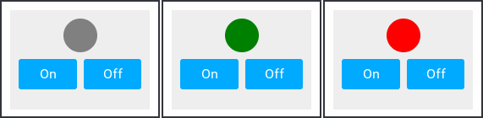
Recognizing component boundaries cont’
This is a Panel with a colored Circle, and two custom buttons that change its color. We already have several options for how to split this up:
Everything as one component:
<StackPanel ux:Class="StatusPanel" ...>
...
</StackPanel>

Slide 118
Recognizing component boundaries cont’
Or we can componentize the two buttons:
<StackPanel Margin="10" Padding="10" Color="#eee" ItemSpacing="8">
<Circle ux:Name="status" Width="40" Height="40" Color="Gray" />
<OnOffButtons />
</StackPanel>

Slide 119
Recognizing component boundaries cont’
<Grid ux:Class="OnOffButtons" ColumnCount="2" CellSpacing="8">
<Circle ux:Dependency="status" />
<Panel>
<Text Value="On" Alignment="Center" Margin="8" Color="White"/>
<Clicked>
<Set status.Color="Green" />
</Clicked>
<Rectangle CornerRadius="3" Color="#0af" />
</Panel>
<Panel>
<Text Value="Off" Alignment="Center" Margin="8" Color="White"/>
<Clicked>
<Set status.Color="Red" />
</Clicked>
<Rectangle CornerRadius="3" Color="#0af" />
</Panel>
</Grid>

Slide 120
Recognizing component boundaries cont’
At this point we can see that there is a dependency between the inner workings of the OnOffButtons class and the "status" circle. We might be tempted to call this a dependency from OnOffButtons to a Circle, and declare that using ux:Dependency as we have done in the example above.
This is however a good time to consider whether we have discovered an actual component dependency, or whether this is just a shared view state.
In most cases, it is preferable to have components be as independent as possible. In the example above, we would like to split our components up in a way such that the OnOffButtons component can be used in other situations as well; not only to toggle the color of a Circle.
Let's let these two components share state using JavaScript instead:

Slide 121
Recognizing component boundaries cont’
<Grid ux:Class="OnOffButtons" ColumnCount="2">
<Panel Clicked="{turnOn}">
<Text Value="On" Alignment="Center" Margin="8" Color="White"/>
<Rectangle CornerRadius="3" Color="#0af" />
</Panel>
<Panel Clicked="{turnOff}">
<Text Value="Off" Alignment="Center" Margin="8" Color="White"/>
<Rectangle CornerRadius="3" Color="#0af" />
</Panel>
</Grid>
<JavaScript>
var Observable = require("FuseJS/Observable");
var isOn = Observable(false);
function turnOn() { isOn.value = true; }
function turnOff() { isOn.value = false; }
module.exports = { isOn: isOn, turnOn: turnOn, turnOff: turnOff };
</JavaScript>

Slide 122
Recognizing component boundaries cont’
<StackPanel Margin="10" Padding="10" Color="#eee" ItemSpacing="8">
<Circle ux:Name="status" Width="40" Height="40" Color="Gray" />
<WhileTrue Value="{isOn}">
<Change status.Color="Green" />
</WhileTrue>
<WhileFalse Value="{isOn}">
<Change status.Color="Red" />
</WhileFalse>
<StatusCircle/>
<OnOffButtons />
</StackPanel>

Slide 123
Recognizing component boundaries cont’
This time, our two components are independent of each other. They are, however, not independent of the view model (the JavaScript tag). Notice that the OnOffButtons component now has data-bindings that reach outside the component itself. While this works fine, and can be very useful, it can reduce code clarity and creates an unnecessary dependency on the view-model.
Let's instead add a ux:Property to the component which we can then data-bind at the point of instantiation:

Slide 124
Recognizing component boundaries cont’
<Grid ux:Class="OnOffButtons" ColumnCount="2">
<bool ux:Property="Value" />
<Panel HitTestMode="LocalBounds">
<Text Value="On" />
<Clicked>
<Set this.Value="true" />
</Clicked>
</Panel>
<Panel>
<Text Value="Off" />
<Clicked>
<Set this.Value="false" />
</Clicked>
</Panel>
</Grid>

Slide 125
Recognizing component boundaries cont’
<JavaScript>
var Observable = require("FuseJS/Observable");
var status = Observable(false);
module.exports = { status: status };
</JavaScript>

Slide 126
Recognizing component boundaries cont’
<StackPanel Margin="10" Padding="10" Color="#eee" ItemSpacing="8">
<Circle ux:Name="status" Width="40" Height="40" Color="Gray" >
<WhileTrue Value="{status}">
<Change status.Color="Green" />
</WhileTrue>
<WhileFalse Value="{status}">
<Change status.Color="Red" />
</WhileFalse>
</Circle>
<OnOffButtons Value="{status}"/>
</StackPanel>

Slide 127
Recognizing component boundaries cont’
The "status" circle is at this point a good candidate for componentization as well, just to increase the readability and maintainability of our UX:
<Grid ux:Class="OnOffButtons" ColumnCount="2">
<bool ux:Property="Value" />
<Panel HitTestMode="LocalBounds">
<Text Value="On" />
<Clicked>
<Set this.Value="true" />
</Clicked>
</Panel>
<Panel>
<Text Value="Off" />
<Clicked>
<Set this.Value="false" />
</Clicked>
</Panel>
</Grid>
<Circle ux:Class="StatusCircle" Width="40" Height="40" Color="Gray" />
<bool ux:Property="Status" />
<WhileTrue Value="{ReadProperty Status}">
<Change status.Color="Green" />
</WhileTrue>
<WhileFalse Value="{ReadProperty Status}">
<Change status.Color="Red" />
</WhileFalse>
</Circle>

Slide 128
Recognizing component boundaries cont’
Now we have two independent components, with clearly defined interfaces.
<JavaScript>
var Observable = require("FuseJS/Observable");
var status = Observable(false);
module.exports = { status: status };
</JavaScript>
<StackPanel Margin="10" Padding="10" Color="#eee" ItemSpacing="8">
<StatusCircle Status="{status}" />
<OnOffButtons Value="{status}" />
</StackPanel>

Slide 129
Referencing files through properties
There are cases where we would like to pass references to files to our components. Examples include embedding images or videos. We can do this by creating properties of the type FileSource and then property-bind the Fileproperty of the Image or Video object to it. Then we can reference local files by their path when we instantiate our class:
<App>
<Panel ux:Class="TestComponent">
<FileSource ux:Property="ImageFile" />
<FileSource ux:Property="VideoFile" />
<Grid Rows="1*,1*">
<Image File="{ReadProperty ImageFile}" Margin="10"/>
<Video File="{ReadProperty VideoFile}" AutoPlay="true" IsLooping="true"/>
</Grid>
</Panel>
<TestComponent ImageFile="test.png" VideoFile="testvideo.mp4"/>
</App>

Slide 130
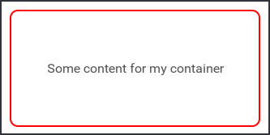
Container
The Container class can be used as a base class when creating components that should position its children deeper into its own subtree. Here is a quick example:
Check out the reference documentation for container for a more details.
<Container ux:Class="MyContainer" Subtree="innerPanel">
<Rectangle ux:Binding="Children" CornerRadius="10" Margin="10">
<Stroke Color="Red" Width="2" />
<Panel Margin="10" ux:Name="innerPanel" />
</Rectangle>
</Container>
<MyContainer>
<Text Value="Some content for my container" Alignment="Center"/>
</MyContainer>

Slide 131
Templates (ux:Template)
Templates can be used to increase the customizability of a component by allowing it to take custom objects to be used as its appearance. An example of this in action is the PageIndicator, which spawns an object from a template for each page in a PageControl. An element is made into a template by setting the ux:Template attribute to a name you want to identify that template by. This name is used by elements which accepts templates as children. Check out the ux:Template docs for more details.
Templates can be instantiated using an Each. Each has a property called TemplateSource, which specifies the node in which Each looks for templates. As mentioned before, templates identify themselves by a name. The TemplateKey property specifies which template Each should use, if it is available.
Here we set TemplateSource="this" because Each should look for the key in its parent class (CoolRepeater):

Slide 132
Templates (ux:Template) cont’
This is a custom component which accepts a template, which it repeats 20 times. If no template is given, the Each will fallback to its default template: whatever is inside the Each. The custom component can then be used like this:
<StackPanel ux:Class="CoolRepeater" Background="#FAD">
<Each TemplateSource="this" TemplateKey="Item" Count="20">
<Text>Default template</Text>
</Each>
</StackPanel>
<CoolRepeater>
<Text ux:Template="Item">Hello, world!</Text> </CoolRepeater>

Slide 133
Responsive layout

Slide 134
Responsive layout
When making apps for a wide range of mobile devices, we're facing a huge number of different screen sizes, pixel densities and aspect ratios. How do you make a fully responsive app that adapts to these constraints? Fuse solves the challenge by using a basic set of layout rules and triggers, which you should know and understand in order to be effective in Fuse.

Slide 135
Units of measurement
There are several units of measurement you can use to describe element dimensions. The default unit is points (pt). The advantage of using points is that an element with explicit dimensions appears the same size on screens of different pixel densities. There is also a percentage unit (%), which can be used to define the size of an element to be a percentage of its available size. For the odd case where you need to specify the exact amount of pixels you want an element to occupy, we have the pixel (px) unit. Note however that when using this unit of measurement, elements will have different sizes on different screen densities.
You can specify the unit of a number by appending either pt, px or % (note that we don't need to specify pt as that becomes the unit if we only specify the number):
<Panel Width="50%" Heigh="100px" />

Slide 136
Using images in responsive layout
When using images in Fuse apps, you should try to make them match the intended target size on screen. Scaling the image up or down significantly will likely result in visible aliasing artefacts. You should use MultiDensityImageSource to supply several versions of the same image for use on screens of different pixel densities. This lets us avoid up-/downscaling in the cases where the image would otherwise not match its intended size on screen as a result of changes in pixel density between screens.

Slide 137
Basic building blocks
Fuse comes with an extremely powerful layout system that lets you create UIs that fit on many different screen sizes and aspect ratios. UIs in Fuse are created by a hierarchy of various Panel types, as well as other primitives like Rectangle, Circle and Image. The various Panel types, like StackPanel, Grid and DockPanel, are used to position and size multiple elements relative to each other as well as relative to the available space.

Slide 138
Available space concept
Let's start with the concept of available space. As you might expect, when you have an empty application, the available space is the whole screen of the mobile device, including the area behind status and action bars:
Now, most of the visual elements placed inside of the app tag will by default try to be as big as possible and fill up all available space (there are exceptions, such as StackPanel):
<App>
</App>
<App>
<Panel>
</Panel>
</App>

Slide 139
Available space concept cont’
However, sometimes we don't want our elements to occupy all available space, but instead subdivide that space and distribute it amongst several elements:
<App>
<DockPanel>
<Panel Dock="Top" Height="56" Color="Blue" />
<Panel Dock="Bottom" Height="56" Color="Green" />
<Panel Color="Yellow">
</Panel>
</DockPanel>
</App>

Slide 140
Available space concept cont’
In this example, the DockPanel fills up all available space, then inside it is a 56pt tall blue Panel that is docked to the top edge. The green Panel is also 56pt high, but it is docked to the bottom edge. Since there are no horizontal constraints on the two panels (like the Width property for example), they stretch to fill the full width of the available space, which in this case is the full width of the screen.
The yellow Panel automatically takes up the remaining available space, which is now the whole area between the blue and green panels.
Assigning a Dock property to an element within a DockPanel ensures it takes up as little space as possible either vertically (when docked to the top or bottom) or horizontally (when docked to the left of right).

Slide 141
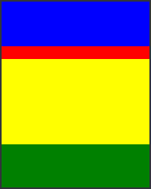
Alignment affects layout
With the available space concept settled firmly, let's move on and throw Alignment into the mix!
<App>
<DockPanel>
<Panel Dock="Top" Height="56" Color="Blue" />
<Panel Dock="Bottom" Height="56" Color="Green" />
<Panel Color="Yellow“>
<Panel Color="Red" Alignment="Top" Height="16" />
</Panel>
</DockPanel>
</App>

Slide 142
Alignment affects layout cont’
In this case, the nested red Panel with Alignment="Top" set will take up only 16pt vertically, and be aligned to the top of the yellow Panel. When we assign an Alignment to an element, it tries to stick to the particular side of its parent and take up as little space in the respective direction as possible. The red Panel still stretches to fill the full width of the available space since there are no horizontal constraints set on it.
At this point you might wonder what the difference between "docking" something in a DockPanel and aligning something is. Although the two have similar effects, the most important difference is that aligning something does not subdivide its parents available space. What we mean by this is that the red Panel in the previous example does not "spend" its parent available space (as was done by the blue and green panels), it is instead just a way of declaring where panel should appear in the case where it is smaller (or bigger) than its parent in one or more dimensions.
If we remove the explicit Height on the red Panel and add some child elements with non-zero dimensions inside of it, the children will push the parent dimensions to accommodate the tallest child, the 200pt high maroon Panel in this case:

Slide 143
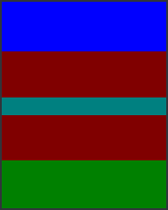
Alignment affects layout cont’
<App>
<DockPanel>
<Panel Dock="Top" Height="56" Color="Blue" />
<Panel Dock="Bottom" Height="56" Color="Green" />
<Panel Color="Yellow">
<Panel Color="Red" Alignment="Top">
<Panel Color="Teal" Height="20" />
<Panel Color="Maroon" Height="200" />
</Panel>
</Panel>
</DockPanel>
</App>

Slide 144
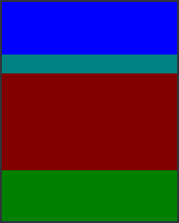
Alignment affects layout cont’
Other Panel types behave slightly differently. For example, let's take a look at StackPanel:
<App>
<DockPanel>
<Panel Dock="Top" Height="56" Color="Blue" />
<Panel Dock="Bottom" Height="56" Color="Green" />
<Panel Color="Yellow">
<StackPanel Color="Red" Alignment="Top">
<Panel Color="Teal" Height="20" />
<Panel Color="Maroon" Height="200" />
</StackPanel>
</Panel>
</DockPanel>
</App>

Slide 145
Alignment affects layout cont’
A vertical StackPanel stacks its children one after the other, and stretches to accommodate the combined height of all children. The red StackPanel in the example above is now 220 points high and aligned to the top of the yellow Panel. You can find more details on StackPanel behaviour in StackPanel docs.
It's worth noting that aside from Alignment, other visual properties have an effect on the layout calculation too. These include Width, Height, MinWidth, MinHeight, MaxWidth, MaxHeight, X, Y, Margin, Padding and a few more. When setting such properties, be sure to always test how your layout looks on different target devices.

Slide 146
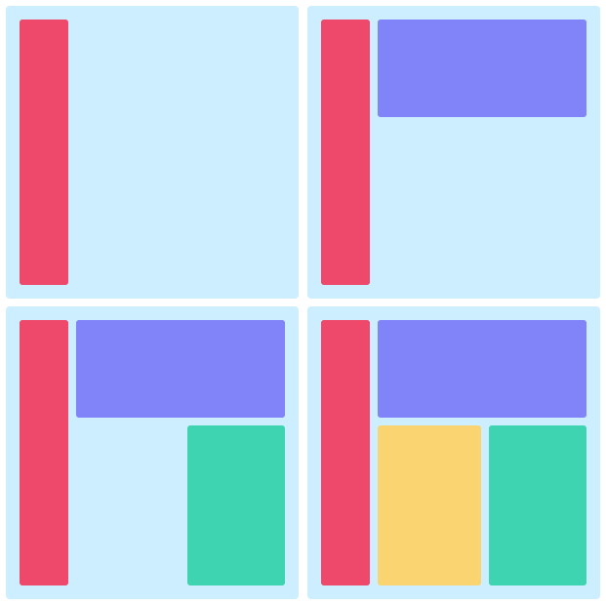
List of commonly used layout controls
DockPanel
DockPanel is one of the most frequently used layout containers. It lets us dock elements to its sides, consuming that space in the process so that the next item being docked only considers the remaining space. See the DockPanel docs for more details.
<DockPanel>
<Rect Dock="Left" Color="Red" Width="50" />
<Rect Dock="Top" Color="Blue" Height="100" />
<Rect Dock="Right" Color="Green" Width="100" />
<Rect Color="Yellow"/>
</DockPanel>

Slide 147
List of commonly used layout controls cont’
StackPanel
As the name suggests, you want to use a StackPanel for stacking items. This is very useful when creating lists of items, but it's applicable in any situation when you need to stack elements either vertically or horizontally. We often use StackPanel when we don't know exactly how many items we need to display. The StackPanel can just grow to fit as many children as it is given (unlike the DockPanel for example). Because of this, a StackPanel can grow to become larger than its parent, overflowing its available size. See the StackPanel docs for more details.

Slide 148
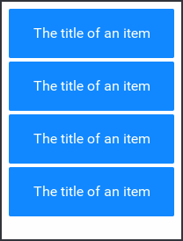
List of commonly used layout controls cont’
<StackPanel Alignment="Top" Margin="8" ItemSpacing="4">
<Each Count="4">
<Panel Height="56">
<Text Value="The title of an item" Alignment="Center" Color="#fff" />
<Rectangle Layer="Background" Color="#18f" CornerRadius="2" />
</Panel>
</Each>
</StackPanel>

Slide 149
List of commonly used layout controls cont’
Grid
Grid comes in handy when you need to build a responsive layout with flexible row or column sizes. By default, elements in a Grid are placed in the order they appear in UX, from left to right, top to bottom. However, you have full control over how a Grid behaves by using its properties RowCount and ColumnCount, or Rows and Columns. You can also explicitly tell each child to which row and column it should attach itself by using the Row, Column, RowSpan and ColumnSpan properties. See the Grid docs for more details.

Slide 150
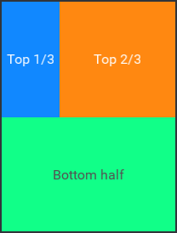
List of commonly used layout controls cont’
<Grid RowCount="2" Columns="1*,2*">
<Panel Color="#18f">
<Text Value="Top 1/3" Alignment="Center" Color="#fff" />
</Panel>
<Panel Color="#f81">
<Text Value="Top 2/3" Alignment="Center" Color="#fff" />
</Panel>
<Panel ColumnSpan="2" Color="#1f8">
<Text Value="Bottom half" Alignment="Center" />
</Panel>
</Grid>

Slide 151
List of commonly used layout controls cont’
WrapPanel
The WrapPanel is used when you need to lay out children one after another in a given orientation, and wrap around whenever you reach the end of the available space in a particular direction. By default it lays its children out horizontally, and wraps around vertically. See the WrapPanel docs for more details.

Slide 152
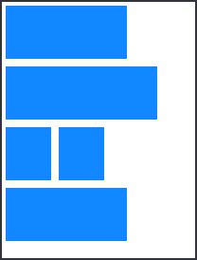
List of commonly used layout controls cont’
<App>
<WrapPanel>
<Panel Width="128" Height="56" Margin="4" Color="#18f" />
<Panel Width="160" Height="56" Margin="4" Color="#18f" />
<Panel Width="48" Height="56" Margin="4" Color="#18f" />
<Panel Width="48" Height="56" Margin="4" Color="#18f" />
<Panel Width="128" Height="56" Margin="4" Color="#18f" />
</WrapPanel>
</App>

Slide 153
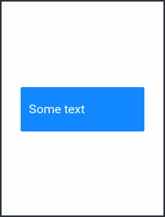
List of commonly used layout controls cont’
Panel
A Panel is arguably the simplest container in Fuse. You want to use Panel when you want to position its children in the same area of available space without subdividing it like for example DockPanel does. Details can be found here.
<Panel Height="56" Margin="24,0">
<TextInput Value="Some text" TextColor="#fff" Margin="10"/>
<Rectangle Color="#18f" CornerRadius="2" />
</Panel>

Slide 154
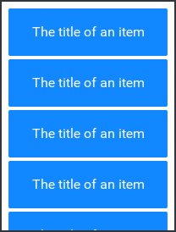
List of commonly used layout controls cont’
ScrollView
A ScrollView is generally used to display content that is bigger than the screen of the device. A prominent example are lists of items. Note that a ScrollView can only have a single visual child. Since ScrollView by default occupies the whole available space, we usually place a StackPanel inside it in order to make a scrollable list.
<ScrollView>
<StackPanel Margin="8" ItemSpacing="4">
<Each Count="24">
<Panel Height="56">
<Text Value="The title of an item" Alignment="Center" Color="#fff" />
<Rectangle Color="#18f" CornerRadius="2" />
</Panel>
</Each>
</StackPanel>
</ScrollView>

Slide 155
Adapting to different screen sizes and orientations
When we're making cross-platform applications that target a broad range of device models, it makes sense to use the additional screen real estate you get when running on larger devices, such as tablets. It is also wise to adapt certain views to whether it is displayed in the portrait or landscape device orientation. Fuse has a set of triggers to handle this: WhileWindowPortrait, WhileWindowLandscape and WhileWindowSize. These can be combined to describe very detailed use cases. We will show you how in the next section!

Slide 156
Hands-on
It's time we use what we've learnt so far and replicate a real-world app design in Fuse. As a popular example, let's take a look at how the Google Docs application behaves on different screens. There are of course many subtle details that change, but here we will replicate the basic structure of the app layout.
On iPhone 6, it has two items in a row while in portrait, and changes that to 3 items when rotated to landscape.

Slide 157
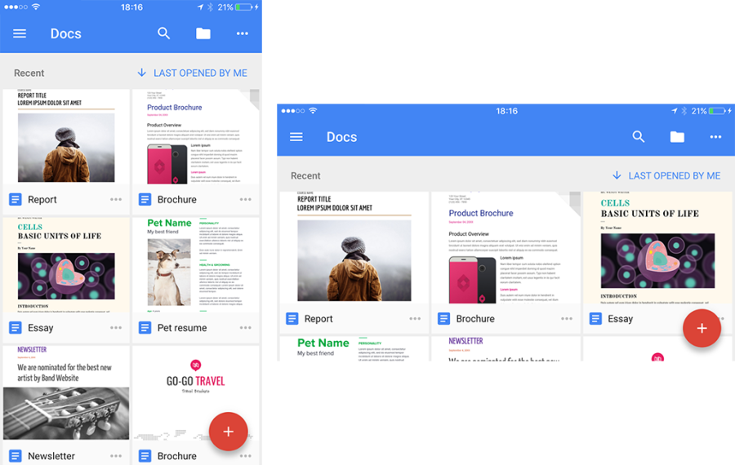
Hands-on cont’

Slide 158
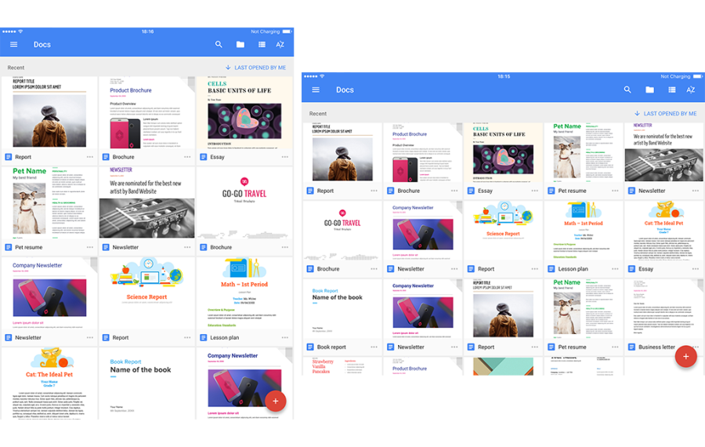
Hands-on cont’
On iPad, it has three items in a row while in portrait, and changes that to 5 items when rotated to landscape.

Slide 159
Hands-on cont’
Let's start with the basic app structure. The first things we take care of are the status and bottom bars - we do not want our app content to be drawn behind them, so we put a DockPanel in the app and dock a StatusBarBackground and BottomBarBackground to its top and bottom. Further more, we set the background color of the status bar to the blue tone that's going to be used for the whole top section of the app.
<App Background="#eee">
<!-- iOS specific status bar styling -->
<iOS.StatusBarConfig Style="Light" />
<DockPanel>
<StatusBarBackground Dock="Top" Background="#4285f4" />
<BottomBarBackground Dock="Bottom" />
</DockPanel>
</App>

Slide 160
Hands-on cont’
Next we add the blue top bar itself that holds our action buttons. Since we already have our parent DockPanel, we only need to specify Dock="Top" on the element and give it a height, and it gets aligned to the very top of the available space, right below StatusBarBackground. We won't add any icons for now, but note that we conveniently made the element a DockPanel so you can easily dock things inside of it later.
Then we add another empty Panel which automatically fills the remaining available space, and is the container that we will put the rest of our content in.

Slide 161
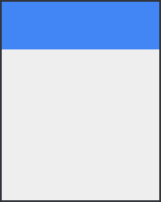
Hands-on cont’
<App Background="#eee">
<!-- iOS specific status bar styling -->
<iOS.StatusBarConfig Style="Light" />
<DockPanel>
<StatusBarBackground Dock="Top" Background="#4285f4" />
<BottomBarBackground Dock="Bottom" />
<DockPanel Dock="Top" Height="56" Color="#4285f4">
<!-- this is the blue top bar that will hold the icons -->
</DockPanel>
<Panel>
<!-- this fills the remaining available space -->
</Panel>
</DockPanel>
</App>

Slide 162
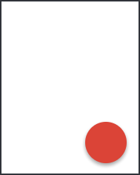
Hands-on cont’
Looking back at the app screenshots, we see that the content area is scrollable, which means that we will have to use a ScrollView. However, there is this red "plus" button that should stay on top of the ScrollView, and not move with it as it scrolls. Because of that, we use a Panel as the parent of the content area, because it allows us to put its children on top of each other:
<Panel>
<Circle Width="56" Height="56" Margin="16" Color="#db4437" Alignment="BottomRight">
<Shadow />
</Circle>
<ScrollView>
</ScrollView>
</Panel>

Slide 163
Hands-on cont’
The scrollable content in the screenshots appears to be arranged in a grid formation with equally sized columns. It makes sense to use a Grid here, since that allows us to change the number of columns our content is going to be put into, and the Grid will adjust as necessary. As we outlined at the top, the number of columns will depend on the screen size of the device the app runs on.
First we need to reserve some space on top of the Grid for a title and an ordering toggle that you can add later. To do that, we first put a StackPanel inside of the ScrollView. In the StackPanel, we put a 56 points tall Panel and the Grid that will hold the items. We specify our Grid to have 2 equally sized columns by default (using the ColumnCount property), and give it a ux:Name so we can refer to it later.

Slide 164
Hands-on cont’
<Panel>
<Circle Width="56" Height="56" Margin="16" Color="#db4437" Alignment="BottomRight">
<Shadow />
</Circle>
<ScrollView>
<StackPanel>
<Panel Height="56" />
<Grid ux:Name="itemGrid" ColumnCount="2" Margin="4" CellSpacing="4">
</Grid>
</StackPanel>
</ScrollView>
</Panel>

Slide 165
Hands-on cont’
The next thing we want to do is to add some placeholder content for the items so that we can style them. To achieve that, we use the Each class. Each is most frequently used for data-binding to arrays of data, but in our case we'll use it as a tool to repeat the same UX multiple times using its Count property.
Inside the Each, we want to define how a single "box", that represents an item, looks like. The Each object will take care of creating 20 instances of it for us. What's tricky about the list items is that their size should adapt to the varying number of columns in the parent Grid as the screen size or orientation changes. This means that we can't set explicit Width or Height on them. Luckily, there's one thing that is certain: we know they need to stay square. We can achieve this by setting BoxSizing="FillAspect" and Aspect="1" on the item. This will stretch the item to fill the available space within the Grid cell that it gets assigned to.

Slide 166

Hands-on cont’
<Grid ux:Name="itemGrid" ColumnCount="2" Margin="4" CellSpacing="4">
<Each Count="20">
<DockPanel BoxSizing="FillAspect" Aspect="1">
</DockPanel>
</Each>
</Grid>

Slide 167
Hands-on cont’
Finally we add some content to the grid items. Note how we set Layer="Background" on the Rectangle that serves as the white background of the item - this ensures that it is sent to the background and does not participate in the layout calculation done by its parent DockPanel.

Slide 168
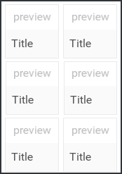
Hands-on cont’
<Grid ux:Name="itemGrid" ColumnCount="2" Margin="4" CellSpacing="4">
<Each Count="20">
<DockPanel BoxSizing="FillAspect" Aspect="1">
<Panel Dock="Bottom" Height="40" Color="#fafafa" Margin="1">
<Text Value="Title" Alignment="CenterLeft" Margin="8,0" />
</Panel>
<Text Value="preview" Alignment="Center" TextColor="#bbb" />
<Rectangle Color="#fff" Layer="Background">
<Stroke Width="1" Color="#eaeaea" />
</Rectangle>
</DockPanel>
</Each>
</Grid>

Slide 169
Hands-on cont’
To make the basic app structure complete, we need to make the Grid adapt to various screen sizes and device orientations. Here we want to use the general approach of describing varying states as deviations from the rest state. Our rest state in this case is a phone in portrait orientation that has two items on each row in the Grid.
The deviations we need to describe then are "phone in landscape", "tablet in portrait" and "tablet in landscape". We start by creating a new WhileTablet trigger that is going to evaluate to true when the screen size in any direction is larger than or equal to 600 points. We chose the number so that it matches Material design guidelines.
Then we couple the new WhileTablet trigger with WhileWindowPortait and WhileWindowLandscape to describe the "how many items per row" rules we set out at the top of the Hands-on section.

Slide 170
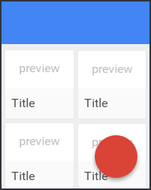
Hands-on cont’
<WhileWindowSize ux:Class="WhileTablet" GreaterThan="599,1" />
<WhileWindowPortrait>
<WhileTablet>
<Change itemGrid.ColumnCount="3" />
</WhileTablet>
</WhileWindowPortrait>
<WhileWindowLandscape>
<WhileTablet>
<Change itemGrid.ColumnCount="5" />
</WhileTablet>
<WhileTablet Invert="true">
<Change itemGrid.ColumnCount="3" />
</WhileTablet>
</WhileWindowLandscape>
With that, our Google Docs app mockup is done. Take a look at the full code below, give it a go and see how it works on different devices!

Slide 171
Declarative animation

Slide 172
Declarative animation
Fuse has a powerful animation system that allows you to write your animations in purely declarative UX markup.
The way we describe animations in Fuse is as deviations from what we call the "rest state". The rest state is the layout as it normally looks, when there has been no external inputs or events. We then apply animations to this rest state in response to input, for example to scale down a button while it is being pressed:
<Button Text="Hello world!">
<WhilePressed>
<Scale Factor="0.8" Duration="0.2" />
</WhilePressed>
</Button>

Slide 173
Declarative animation
The code above shows one of the simplest animations you can make in Fuse. It consists of one "trigger" (the WhilePressed object) and one "animator" (the Scale object). You also see a Button object containing the trigger, and which is therefore the object that will get affected by the Scale animator. There are many different triggers available that allow us to react to a variety of different user inputs and app events. There are also quite a few different animators that allow us to make changes to virtually anything within our app as a response to triggers being activated.
The triggers/animator system is designed so that it reads almost like an English sentence. The example above for instance can be read as follows: "While the button is being pressed, scale it by a factor of 0.8 over a duration of 0.2 seconds.".
Animations are a deviation (or change) from this rest state
This leads to some interesting design choices (such as AddingAnimation playing backwards)

Slide 174
Animators
As mentioned, we use animators to make changes and animate our UI. There is a bunch of different animators to pick from, but you will find that most of your needs are covered by the three transform-animators, Move, Scale and Rotate, and the generic animator Change, which allows us to animate almost any property on any element (like Color, Width / Height, and Opacity).
A really neat thing about Fuse' declarative animation, is that it automatically knows how to undo its own effects. Say we for example change the color of a Rectangle to red using a change animator:
<Rectangle ux:Name="myRectangle" Color="#00f">
<WhilePressed>
<Change myRectangle.Color="#f00" Duration="0.5" />
</WhilePressed>
</Rectangle>

Slide 175
Animators
As soon as the WhilePressed trigger is deactivated, the Change animator knows how to animate back to the original color, even if that color changes from some other source in the meantime. This means that all animation using these animators is only a temporary change, meaning it is in affect only as long as its containing trigger is active.

Slide 176
Common animator properties
There is a set of common properties that you can expect to find on all animators:
Duration - Over how much time the animation should apply its effect
Delay - How long the animator should wait before it starts applying its change
Easing - A function that determines how the animators value should change over time
Take a look here for a neat illustration of how easing curves work
Animators play relative to the moment the trigger they are in is activated. This means that all animators inside a trigger are played simultaneously. In the following example, we have a rectangle that, while pressed, rotates 180 degrees over 0.5 seconds, then fades to blue over a duration half a second.
<Rectangle ux:Name="myRectangle" Color="#f00">
<WhilePressed>
<Rotate Degrees="180" Duration="0.5" />
<Change myRectangle.Color="#00f" Duration="0.5" Delay="0.5" />
</WhilePressed>
</Rectangle>

Slide 177
Easing
Animations are linear by default. This means that while they interpolate between the original value and the target value, the value change happens at a constant rate. This can often lead to unrealistic and stiff animations. The solution to this problem is to change the easing curve using the Easing and EasingBack properties. For the cases when we need a truly custom easing curve, you can use the CubicBezierEasing class. You can find its reference documentation here.
To get started, the CubicInOut easing tends to give a nice result for general use-cases.
<WhilePressed>
<Rotate Easing="CubicInOut" Degrees="180" Duration="0.5" />
<Change Easing="CubicInOut" myRectangle.Color="#00f" Duration="0.5" Delay="0.5" />
</WhilePressed>

Slide 178
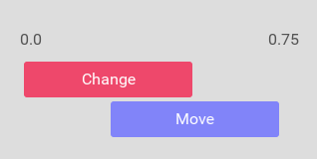
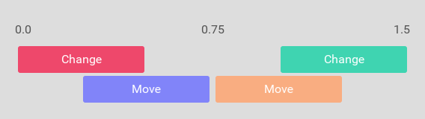
Backwards animation
As we briefly discussed earlier, animators in Fuse know how to reverse themselves so that when their containing triggers gets deactivated, they can return the UI to its rest state automatically. It achieves this by creating a reversed version of its animation under the hood, and playing it back.
Say we have an animation that looks something like this:
The full forward and backward animation can be visualized as follows (where the part after the middle line animates back to the original values).
<Change Duration="0.5" />
<Move Duration="0.5" Delay="0.25" />

Slide 179
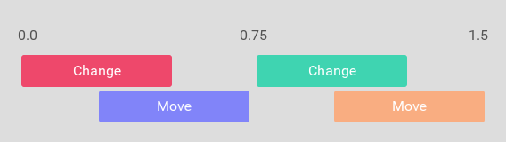
Backwards animation cont’
Here we can see that the backwards animation is a mirror image of the original animation, but there are several ways to control how this backwards animation behaves. The common animator properties each have a corresponding Back variant (DurationBack, DelayBack, and EasingBack). This lets us change the timeline so that it acts differently when the trigger is being deactivated from when its being activated.
Here is an example of the above timeline after we've altered the DelayBack property of both animators as follows:
<Change Duration="0.5" DelayBack="0"/>
<Move Duration="0.5" Delay="0.25" DelayBack="0.25"/>

Slide 180
Backwards animation cont’
For the rare case when we want a completely different set of animators for when a trigger deactivates, we can use the TriggerAnimation class, and bind it to the triggers BackwardAnimation property. Here is an example of what that looks like:
Of course in this case, that means the object will just "jump" straight back to its original position and then rotate as per the Rotate animator in the TriggerAnimation.
<WhileTrue>
<Move X="100" Duration="0.5" />
<TriggerAnimation ux:Binding="BackwardAnimation">
<Rotate Degrees="90" Duration="0.25" />
</TriggerAnimation>
</WhileTrue>

Slide 181
Trigger types
The various triggers in Fuse can be roughly grouped in to three categories: while-triggers, pulse-triggers and animation-triggers. We will discuss their differences in the following sections.

Slide 182
"While" triggers
"While" triggers have in common that they represent a certain state, which is either active or inactive. Some common example are WhilePressed, WhileActive, WhileDragging and WhileTrue. There are a bunch more, and they are all listed here.

Slide 183
Pulse triggers (one-off events)
Pulse triggers represent one-off events, that can occur due to certain input or events, or changes in app state. They are recognizable by their past tense verb names like Clicked, Activated and Scrolled. Since pulse triggers don't represent persistent state, they are deactivated as soon as their animators have completed. This also means that the triggers don't have any inherent duration themselves. If we therefore put animators without any duration on them inside pulse triggers, the animation will happen "instantly" and won't be visible.
<Panel Width="150" Height="50" Color="Blue">
<Clicked>
<Rotate Degrees="180" Duration="0.5" />
</Clicked>
</Panel>

Slide 184
Animation
Some triggers do not play back their animations based on a timer, but instead in response to for example a user gesture. These triggers can be identified by their names, which almost always end with Animation. Some commonly used examples are the AddingAnimation, RemovingAnimation, ScrollingAnimation and SwipingAnimation. Several of these triggers actually do have their own implicit durations, which are bound by the gestures they respond to (and which are defined by the triggers themselves). SwipingAnimation for example activates over the defined range of the SwipeGesture it is connected to. This means that if we don't put any duration on the animators in this trigger, they will extend to the whole range of the trigger, which means that the animators will animate over the whole swipe gesture.

Slide 185
Custom Navigator page transitions
Using the Transition trigger, we can completely customize how pages enter and exit the screen when being navigated to and from using the Navigator class. You can read more about how it is used in the transition reference docs.

Slide 186
Custom PageControl page transitions
The easiest way to customize the animation of pages entering and exiting a PageControl, is to use the EnteringAnimation and ExitingAnimation. Those can be put directly on the page, so give it a completely custom animation:
<Page ux:Class="MyPage" Transition="None">
<EnteringAnimation>
<Move X="-1" RelativeTo="ParentSize" />
</EnteringAnimation>
<ExitingAnimation>
<Move X="1" RelativeTo="ParentSize" />
</ExitingAnimation>
</Page>

Slide 187
Custom PageControl page transitions cont’
Since the PageControl already defines how to animate pages as the user swipes, we need to disable this if we want to add our own. We do this by setting the Transition property of the Page to None.
The EnteringAnimation and ExitingAnimation can be a source of confusion for people who first encounter them, but we'll try to explain them here:
The "current" page in a PageControl is the one the user is currently looking at. Swiping to the left causes the current page to "enter" with the animations defined by the EnteringAnimation, and causes the next page to "exit backwards" with the animations defined by the ExitingAnimation, played backwards. Why is ExitingAnimation played backwards you might wonder? Well, this is because the rest states of our page is defined as the way it looks while being the current page. Its animation then defines the offset from that rest state and how it is moved out of the way before it enters.

Slide 188
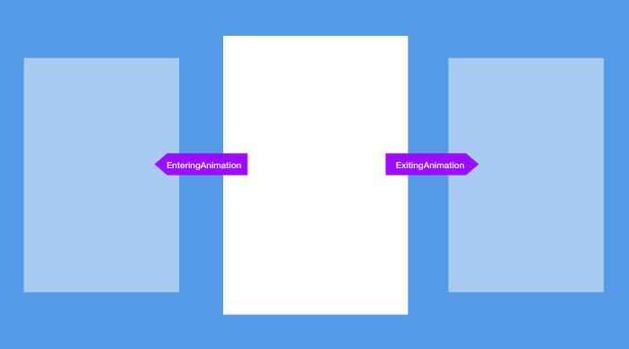
Custom PageControl page transitions cont’
You might wonder what happens when the user swipes to the right? This actually causes the previous page to "enter backwards (causing it to re-enter the screen)" and the "current" page to "exit forwards (causing it to exit the screen)" This means that in this case, the EnteringAnimation is played backwards while the ExitingAnimation is played forwards.

Slide 189
Custom PageControl page transitions cont’
Summarized:
EnteringAnimation describes what happens to the "current" page as we move to the "next" page.
ExitingAnimation describes what happens to the "current" page as we move to the "previous" page
When moving to the next page, we play
The current page's EnteringAnimation forwards
The next page's ExitingAnimation in reverse
When moving to the previous page, we play
The current page's ExitingAnimation
The previous page's EnteringAnimation in reverse

Slide 190
ProgressAnimation
Some controls, like Slider and Video have an inherent progress property, which we can animate in response to using the ProgressAnimation trigger. What progress means in either context depends on the control itself. For a Slider for example, progress represents an arbitrary value, while for Video, progress represents how far into playback we have come. In either case however, progress is reported as a value between 0 and 1. WebView uses progress to report how far it's come in loading a page, which we can for example use to implement a custom loading bar.

Slide 191
ProgressAnimation cont’
Here is an example of how ProgressAnimation can be used with a Slider to scale and rotate a Rectangle in response to the slider being slid by the user.
<Panel>
<Slider>
<ProgressAnimation>
<Scale Target="myRect" Factor="0.5" />
<Rotate Target="myRect" Degrees="180" />
</ProgressAnimation>
</Slider>
<Rectangle ux:Name="myRect" Width="250" Height="250" Color="Red" />
</Panel>

Slide 192
Elements inside triggers
A very useful feature of triggers is that they can also contain arbitrary elements. When the trigger is activated, the elements become rooted to the visual tree, meaning it becomes visible. This is in general a nice way to show and hide elements. Another neat thing about showing elements this way is that this causes them to be added and removed, meaning we can utilize AddingAnimation and RemovingAnimation to animate the elements as they are shown and hidden.
The following example shows how we can display a Rectangle with a nice fading animation using a WhileTrue trigger. Note that the AddingAnimation trigger does not animate back when the element is removed, and thus we also need a RemovingAnimation to make the Rectangle fade back out. Another thing to note here is that the AddingAnimation animated backwards when the element is added to the visual tree. This is, like with EnteringAnimation and ExitingAnimation because we want to describe the animation as a deviation from the rest state, which in this case is how the Rectangle looks when it is visible.

Slide 193
Elements inside triggers cont’
<WhileTrue>
<Rectangle ux:Name="rect" Color="Red" Width="100" Height="100">
<AddingAnimation>
<Change rect.Opacity="0" Duration="0.2"/>
</AddingAnimation>
<RemovingAnimation>
<Change rect.Opacity="0" Duration="0.2"/>
</RemovingAnimation>
</Rectangle>
</WhileTrue>

Slide 194
Structuring app resources

Slide 195
Structuring app resources
In this article we will discuss best practices around managing assets and resources in Fuse projects.
We usually separate between resources and assets as follows:
Assets usually come in the form of files containing content like images, videos or fonts.
Resources define certain values that can be used throughout our app, like colors, font declarations (which acts as a reference to a font file usable in our apps) or strings with different translations.

Slide 196
Folder structure
We like to keep files organized according to which role they fulfill in our app. Thusly, we usually create a Resourcesfolder and an Assets folder, where we put our resources and assets respectively. Beyond this, feel free to further organize your assets and resources in subsequent subfolders.

Slide 197
Example
MyApp/
MyApp.unoproj
MainView.ux
Components/
Pages/
Resources/
ColorPalette.ux
ColorTheme.ux
Fonts.ux
Assets/
Fonts/
RobotoBold.ttf
RobotoRegular.ttf
Images/
DefaultAvatar.png
SplashScreen.jpg

Slide 198
Resources
A resource in Fuse is a value that we associate with a key (a name), so that it can be referenced by that key instead of having to replicate the exact value in multiple places. Examples of values that we prefer to make resources for include colors, fonts, strings and even margins and paddings. Another very useful aspect of resources is that they can be overridden at any time, meaning we can use this to define color palettes / themes that we can swap out even while the app is running.
There are two ways we can define resources and while they act in a similar way, they have some subtle but important differences.
Static resources are defined using the ux:Global attribute and allow us to associate a value with a key and make it available globally in our app.
Dynamic resources are defined using the ux:Key attribute and allow us to associate a value with a key. This makes the value available to the entire subtree of where it is defined.

Slide 199
Resources cont’
Lets take a look at an example:
Here we have defined the name AppBackground to refer to the blueish color #7FDBFF. This value can then be used like so, anywhere in our app:
<float4 ux:Global="AppBackground" ux:Value="#7FDBFF" />
<Rectangle Color="AppBackground" />

Slide 200
Resources cont’
Defining static resources / globals with meaningful names like this lets us easily tweak the look and feel of our app with only a single code change, even though the color is used in many places.
A limitation of static globals is that they cannot be changed while the app is running. For that use-case, we have dynamic resources:
<Panel>
<float4 ux:Key="AppBackground" ux:Value="#7FDBFF" />
<Rectangle Color="{Resource AppBackground}"/>
</Panel>

Slide 201
Resources cont’
In the above example we've defined the same color, but as a dynamic resource instead. There are a couple things to notice about this snippet. We have wrapped the Rectangle and float4 resource in a Panel to illustrate that the resource has to be either a sibling of the Rectangle, or belong to one of its ancestors in order to be visible. Since we put it on the Panel it is available to the panels descendants, or any of its descendants. You might also have noticed that we needed to use a special binding syntax in order to access this resource: {Resource AppBackground}. Since the resource might change while the app is running, we need to create a binding here so that our Rectangle is notified whenever that occurs.
The {Resource <key>} binding also works for static resources defined using ux:Global. It will first look for a dynamic resource defined by ux:Key, but if none is present, it will pick the static one by the same name instead.

Slide 202
Color palettes
When defining a color palette for our app, it can be a good idea to put it in its own file. This way we don't get a long list of color definitions cluttering our UI code, and it becomes easier to make color changes at a later stage. One detail of Fuse is that all files must define a ux:Class in order to be included in the app. When we just want to define a bunch of resources however, we don't want to also have to define a class to contain them. To make grouping resources more convenient, UX markup has a special tag called ux:Resources, which is used as follows:
All resources defined inside ux:Resources tags are automatically included in the app.
<ux:Resources>
<float4 ux:Global="MyApp.RedColor" ux:Value="#F44336" />
<float4 ux:Global="MyApp.PrimaryColor" ux:Value="MyApp.RedColor" />
<float4 ux:Global="MyApp.TopBarBackgroundColor" ux:Value="MyApp.PrimaryColor" />
</ux:Resources>

Slide 203
Tips on structuring color palettes
You should define all colors as static resources using ux:Global. Instead of using these globals directly however, it is a good idea to instead use the {Resource <key>} binding syntax so we can easily define various color schemes at a later stage.
It's better to use semantic names for colors. For example, instead of naming colors after their value, like RoseGold or MintGreen, use names that hint to where in the app the colors should be used, like LightBackgroundColor, DarkTextColor or MainAccentColor.

Slide 204
Themes
The current way of creating themes in Fuse is to simply group all resources associated with the theme in an active trigger:
ColorPalette.ux
MyTheme.ux
<ux:Resources>
<float4 ux:Global="Sienna" ux:Value="#a0522d" />
<float4 ux:Global="SkyBlue" ux:Value="#7ec0ee" />
<float4 ux:Global="MyApp.PrimaryColor" ux:Value="Sienna" />
</ux:Resources>
<WhileTrue ux:Class="MyTheme" Value="true">
<float4 ux:Global="MyApp.PrimaryColor" ux:Value="SkyBlue" />
</WhileTrue

Slide 205
Themes cont’
We can then very easily use this theme in our app by adding it to our app root:
Since MyTheme inherits from the WhileTrue trigger, it can easily be turned on and off by either data-binding its Value property to a JavaScript variable, or with pure UX using for example a Clicked trigger and a Toggle action:
<App>
<MyTheme />
<Panel Color="{Resource MyApp.PrimaryColor}" />
</App>
<App>
<MyTheme ux:Name="myTheme"/>
<Panel Color="{Resource MyApp.PrimaryColor}">
<Clicked> <Toggle Target="myTheme" /> </Clicked>
</Panel>
</App>

Slide 206
Fonts and text styles
Fuse supports both .otf (OpenType) and .ttf (TrueType) font files. In order to make a font available throughout your app you can create a static resource for it:
The font is then ready to be used in Text and TextInput objects by assigning their Font property:
<Font ux:Global="RobotoBold" File="Assets/Fonts/Roboto-Bold.ttf" />
<Text Font="RobotoBold">Hello with Font</Text>

Slide 207
Fonts and text styles
Instead of assigning your custom font to all text objects however we prefer creating a set of text styles using ux:Class and instead use those in our app. This makes it easy to switch our fonts, text size and colors throughout our app by making changes in a single place.
<Text ux:Class="MyApp.TitleText" Font="RobotoBold" FontSize="20"
Color="{Resource MyApp.TitleTextColor}" />
<Text ux:Class="MyApp.BodyText" Font="RobotoRegular" FontSize="13"
Color="{Resource MyApp.BodyTextColor}" />
<StackPanel>
<MyApp.TitleText>This is a title</MyApp.TitleText>
<MyApp.BodyText>And this is some body text...</MyApp.BodyText>
</StackPanel>

